Slide 1
SECURING DATA HIDING IN IMAGES USING STEGANOGRAPHY
CAPSTONE PROJECT
Presented By:
Student Name : Harshal S. Ninawe
College Name : G H Raisoni College of
Engineering & Management , Nagpur
Department : Department of Computer Science & Engineering

Slide 2
OUTLINE
Problem Statement
Technology used
Wow factor
End users
Result
Conclusion
Git-hub Link
Future scope

Slide 3
Problem Statement
In today's digital age, keeping information secure is crucial. Traditional encryption can be complex and easily detected, making image steganography a smarter alternative. This project uses Python and OpenCV to hide secret messages inside images, ensuring secure communication. With a simple password-protected system, only the intended recipient can access the hidden data, making it an easy and effective way to protect sensitive information.

Slide 4
Technology used
Programming Language: Python
Libraries:
OpenCV – For image processing
OS – To handle file operations
String – For character mapping and encryption
Concepts Used:
Image Steganography
Pixel Manipulation
Password-Protected Encryption & Decryption

Slide 5
Wow factors
Innovative Pixel-Level Encryption: The project directly modifies pixel values to embed secret messages, showcasing a unique and creative approach to data security.
User-Friendly Implementation: The simple command-line interface allows users to easily encrypt and decrypt messages with just a password, making it accessible for beginners.
Real-Time Image Processing: Utilizing OpenCV, the tool processes images in real time, demonstrating fast and efficient handling of visual data.
Versatile Application: The concept can be extended to various formats and enhanced with additional security measures, opening doors for future developments in digital security.

Slide 6
End users
Cybersecurity Professionals
For secure communication and data protection.
Journalists & Activists
To safeguard sensitive information from surveillance.
Researchers & Students
For learning and experimenting with steganography.
Individuals & Organizations
Who need a simple yet effective way to encrypt confidential messages.

Slide 7
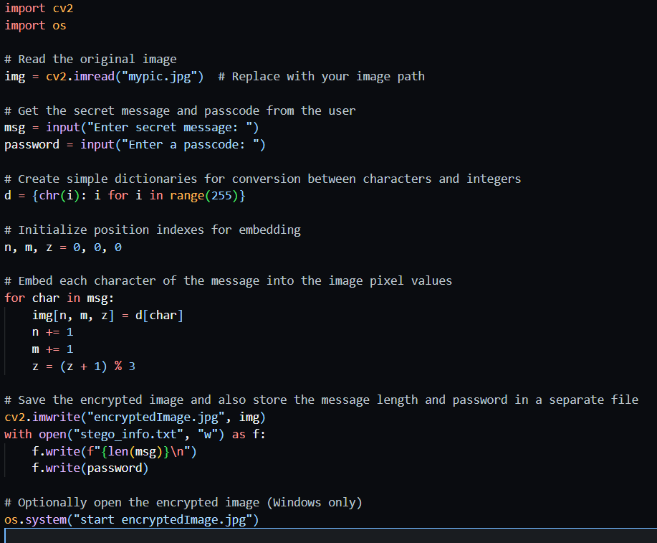
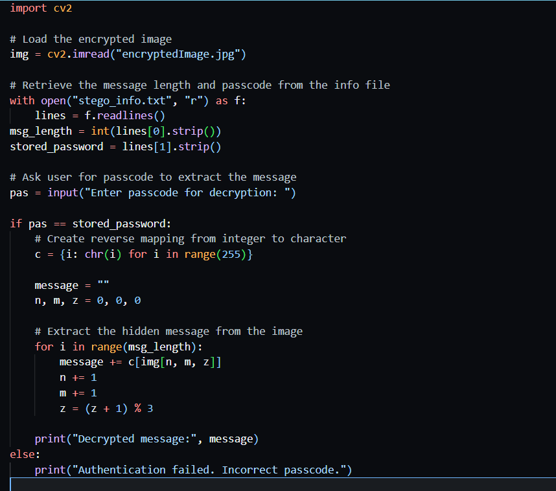
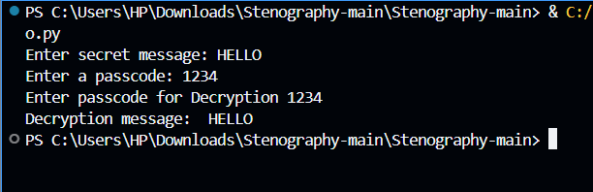
Results
ENCRYPTION
DECRYPTION
OUTPUT

Slide 8
Conclusion
This project successfully demonstrates the use of image steganography for secure message encryption and decryption. By leveraging Python and OpenCV, it provides a simple yet effective way to hide sensitive information within images, ensuring confidentiality. The password-protected system enhances security, making it accessible for users who need a lightweight and efficient method for secure communication. With its potential for further improvements, such as a graphical user interface and support for multiple file formats, this project lays a strong foundation for future advancements in digital privacy and data protection.

Slide 9
GitHub Link
https://github.com/the-money-19/cybersecurity-edunet.git

Slide 10
Future scope
Graphical User Interface (GUI):
Enhancing user experience by developing an interactive application.
Support for Multiple File Formats:
Expanding functionality to embed messages in different image formats like PNG, BMP, and TIFF.
Advanced Encryption Techniques:
Implementing stronger encryption algorithms to improve security.
Increased Capacity:
Optimizing storage methods to embed larger messages without noticeable image distortion.
Mobile & Web Integration:
Developing a mobile or web-based version for broader accessibility.
AI-Based Steganalysis Resistance:
Implementing techniques to evade detection by AI-powered steganalysis tools.

Slide 11
THANK YOU

